Slide 1
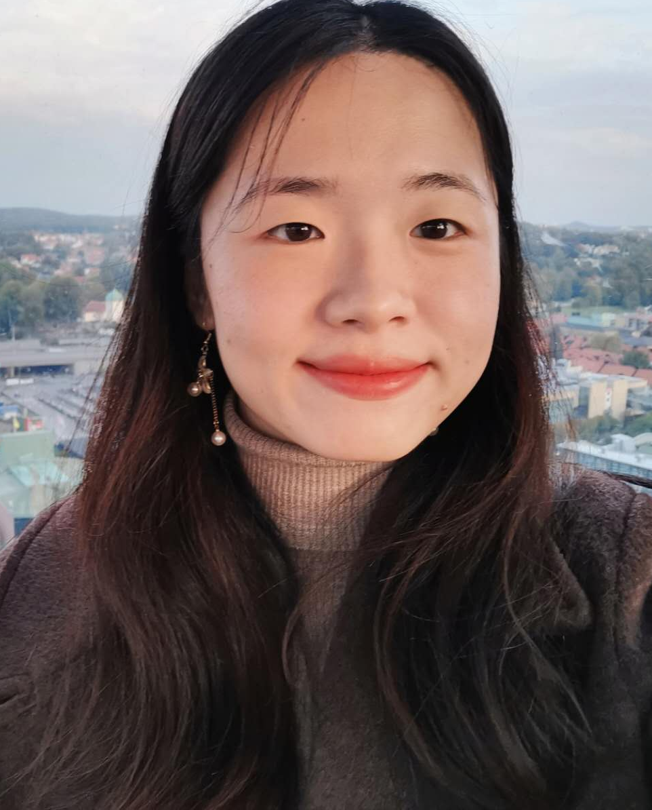
Xingrong Zong
Software Technology
Summary
Friendly, motivated and responsible college senior with a computer science background.
I have a huge interest in logistics, which is what I am studying in full time right now.
I have studied in Sweden and China.
I have a permanent residence permit in Sweden.
Work Experiences
Göteborgs Stad - Kultursommarjobb
Portraitist| Jul 2019 – Aug 2019
SSP The Food Travel Experts - Universeum
Cashier | Jun 2019 – Sep 2019
Svensk Direktreklam
Advertisement Delivery | Apr - Jun 2017
TTS Marine AB
Summer Cleaning Staff | Aug 2016, 2017
Educational History Hermods
International Business Logistics – Green Management
| Sep 2023 – 2025
Logistics and Goods Flow Control
Project Management and Business Communication
Sustainable Transport and Distribution Logistics
Business Economics
International Trade, Payment and Financing
International Purchasing and Sales
Quality and Process Development
International Commercial Law with Environmental Law
Transport Rights and Logistics Agreements
Copenhagen Universitet
Exchange Study | Sep 2021 – Juni 2022
Independent courses in Machine Learning, focusing on Deep Learning
ronazong.work@gmail.com
linkedin.com/in/ronazong
github.com/RonaZong
0761-66 52 46
Ebbe Lieberathsgatan 33B
41265 Gothenburg

Slide 2
Xingrong Zong
Linnaeus University
Software Technology | Sep 2019 – Sep 2023
Computer Science as main area, focuses on programming and software in IT-system
Extra courses in mathematics
Uppsala University
Computer Science| Sep 2018 – Jan 2019
Independent courses in Computer Science
Skills
Communication Skills
Active Listening
Interpersonal Communication
Punctuality
Problem-Solving
Flexibility
Patience
Collaboration
Computer Skills
Python
Java
JavaScript
HTML & CSS
Adobe Photoshop, Illustrator
Inventor
Fusion 360
Microsoft Word, Excel, ...
Google Colab, Docs, ...
Language English - Advanced Swedish - Intermediate (SAS2) Mandarin - Native
References Be provided on request.
ronazong.work@gmail.com
linkedin.com/in/ronazong
github.com/RonaZong
0761-66 52 46
Ebbe Lieberathsgatan 33B
41265 Gothenburg

